Slide 1

Empirical Investigation
MSA-Level Labor Market Development, 1990-2015
10/19/2020

Slide 2
I. Two Occupational Classifications
1. 1990 Mean Wage Ranked, i.e. “12.5% ranked”
Low-paid jobs: Lowest 12.5% ranked in terms of average wages in 1990
High-paid jobs: Highest 12.5% ranked
Middle-paid jobs: All in between
2. PCS French Definition

Slide 3
Plots
Occupational Employment Shares among Working-Age Adults by MSA population, 1990-2015
Occupational Employment Shares among (only) US-Born Workers by MSA population, 1990-2015
The Change in employment shares between 2015 and 1990 for L, M, H jobs per MSA
Changes in employment shares of middle-paid against high-paid jobs for individual cities, 1990-2015 (Percentage Point)
Changes in employment shares of middle-paid against high-paid jobs among US-Born Workers for individual cities, 1990-2015 (Percentage Point)

Slide 4
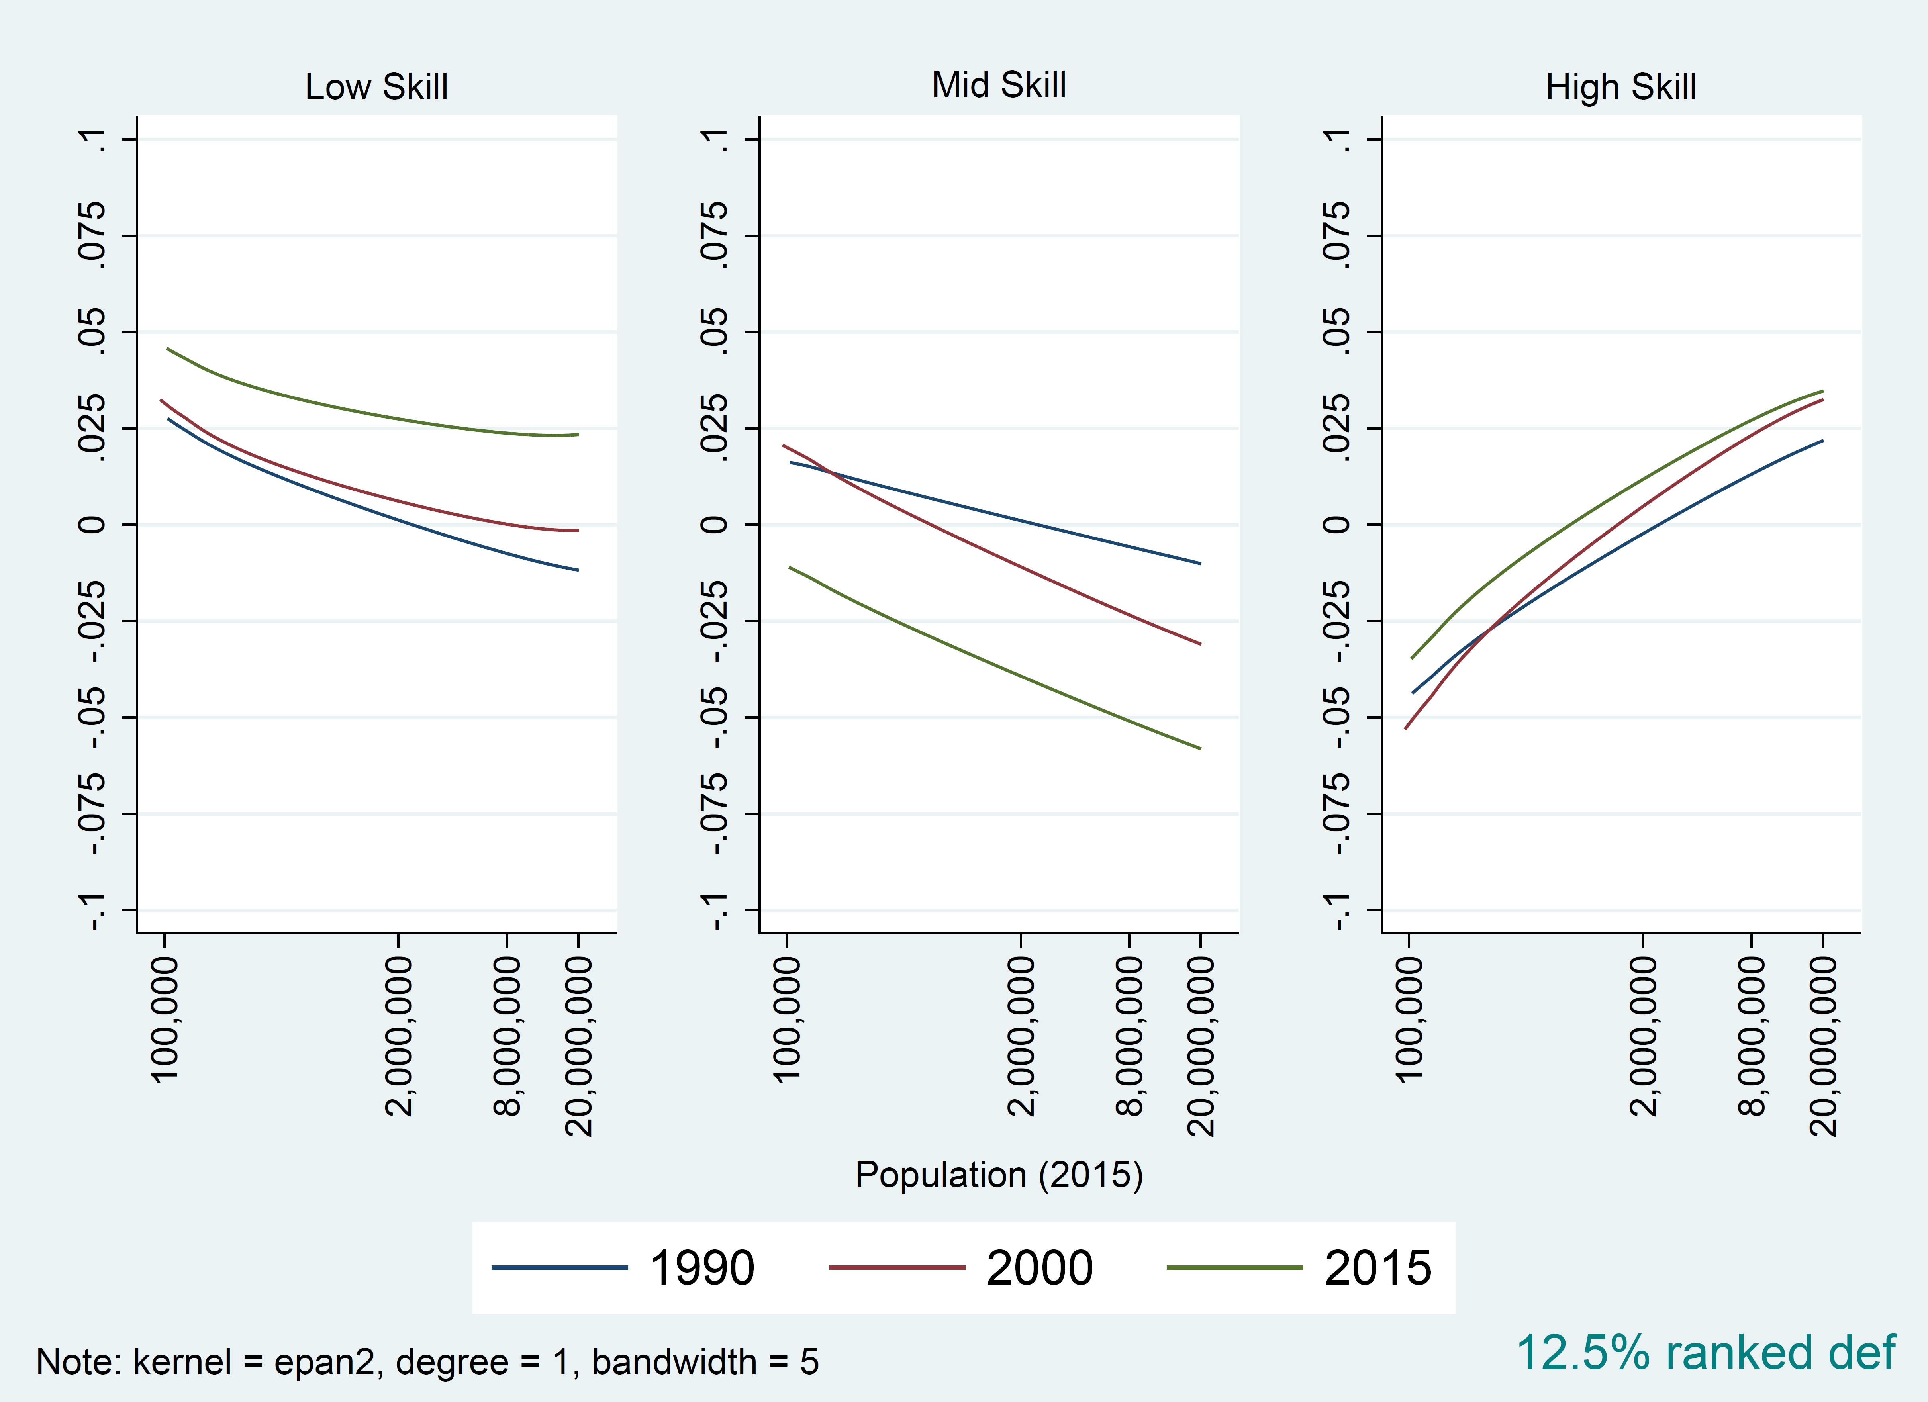
II. Occupational Employment Shares among Working-Age Adults by MSA population, 1990-2015
Notes:
First, we plot the employment shares among working-age adults, level relative to 1990 mean; later we will also look into only US-born workers.
In this case, we didn’t group cities into city bins in advance. Instead, we plotted all the metropolitans against their log(population) using adjusted smoothing kernels
with 1990 mean wage definition, we can observe that larger cities have relatively smaller low-skill & mid-skill jobs shares, while have bigger high-skill jobs share.
We will specifically look at the change between 1990 n 2015 later.

Slide 5
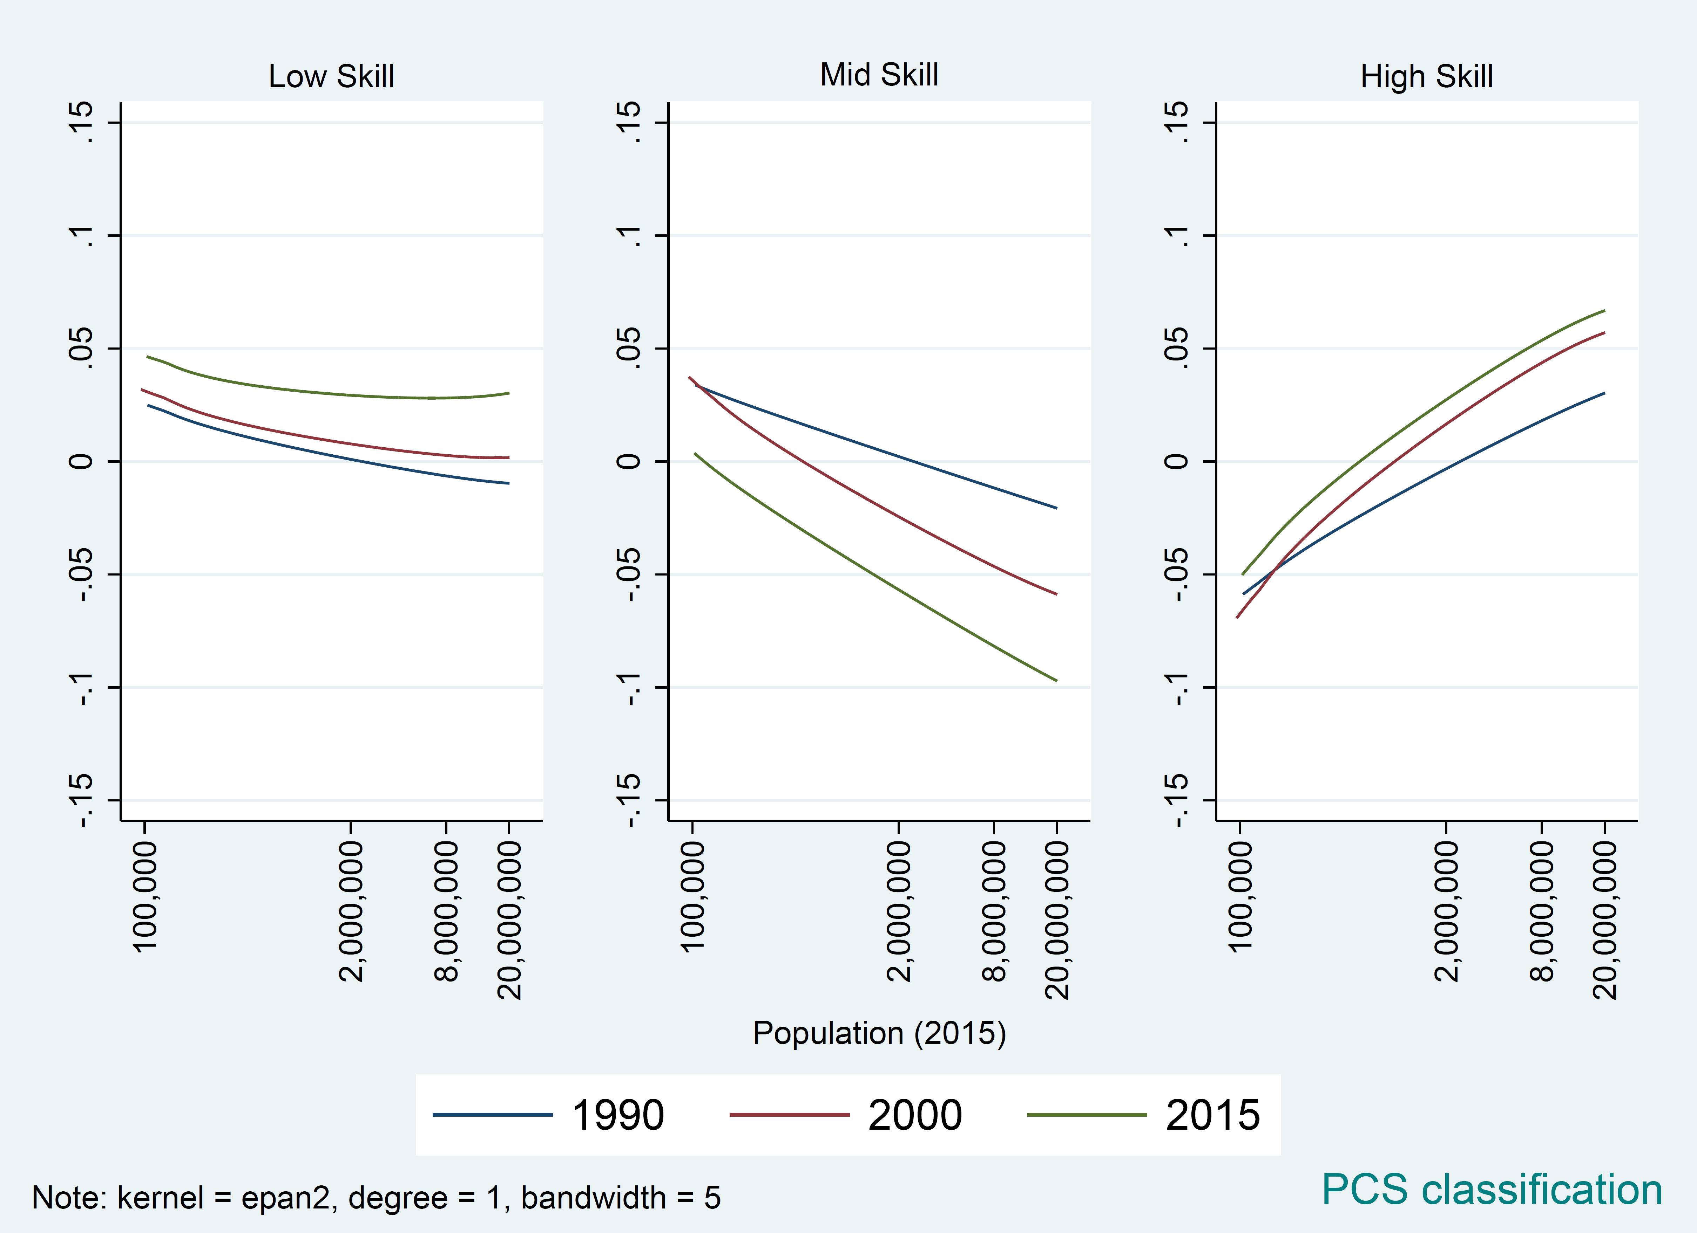
II. Occupational Employment Shares among Working-Age Adults by MSA population, 1990-2015
Notes:
Using our french PCS classification, we have very similar patterns. But the changes for mid- and high- skill jobs are more significant than our previous definition.

Slide 6
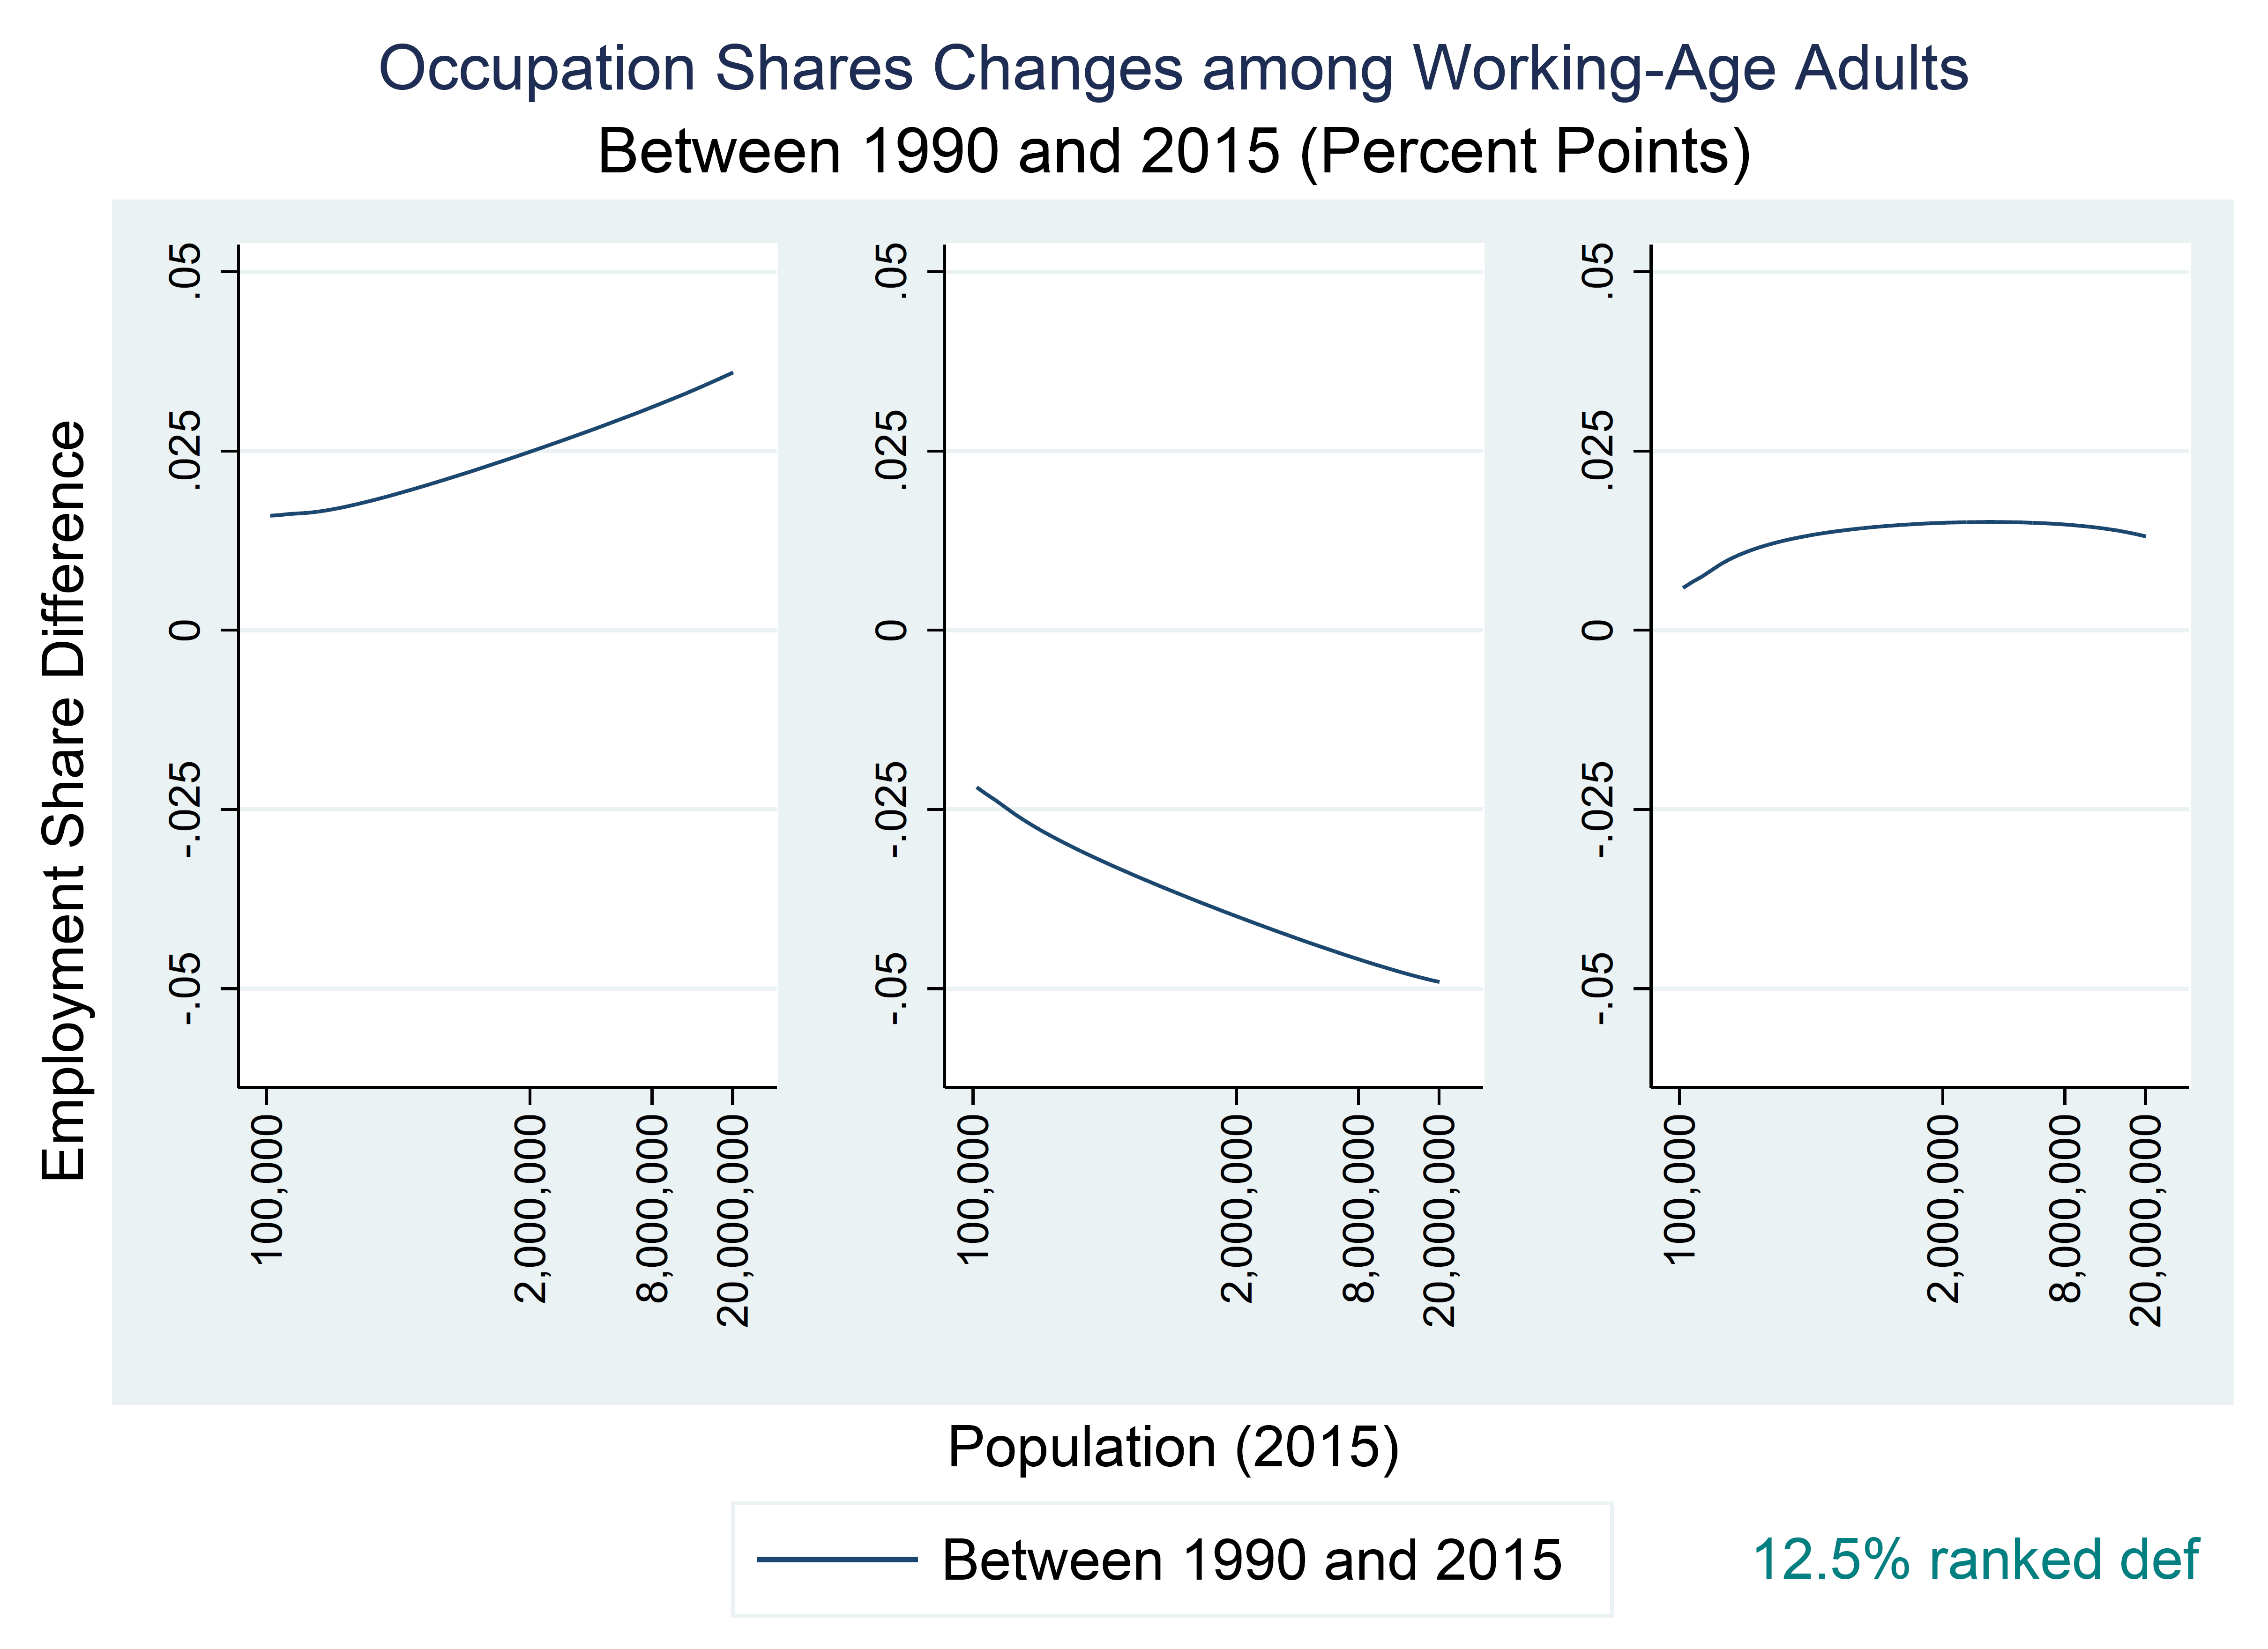
II. Occupational Employment Shares among Working-Age Adults by MSA population, 1990-2015
Notes:
Lets look at the changes between 1990 & 2015.
More-populated cities have larger changes in low-skill and mid-skill occs;
While, for high-skill occs, there seems to be no difference between cities.

Slide 7
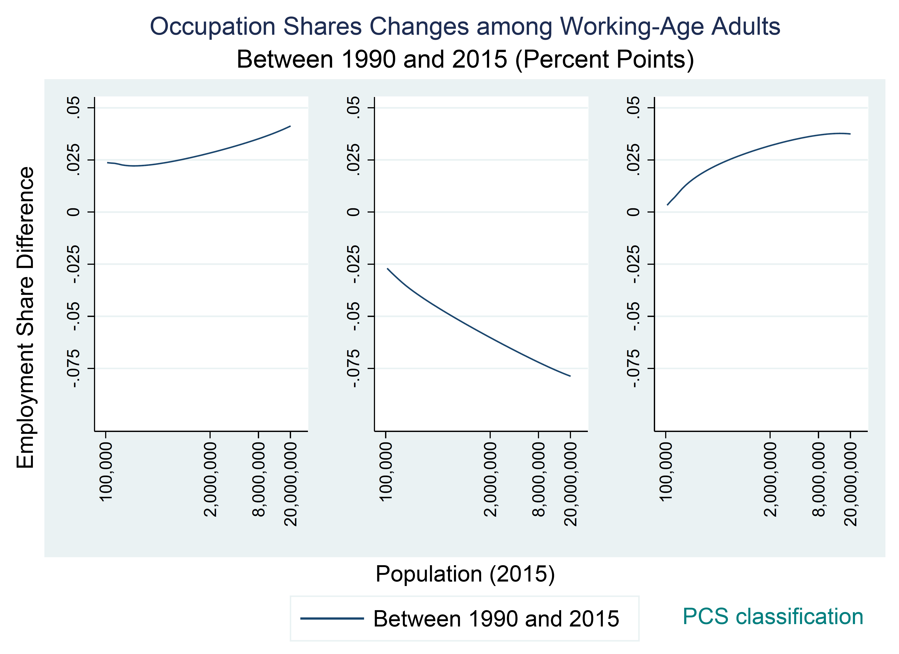
II. Occupational Employment Shares among Working-Age Adults by MSA population, 1990-2015
Notes:
Using our French PCS classification, we have a similar pattern again. But the changes for mid- and high- skill jobs are more significant than our precious definition.
- And now more-populated cities also experience a larger increase in high-skill jobs than the less-populated

Slide 8
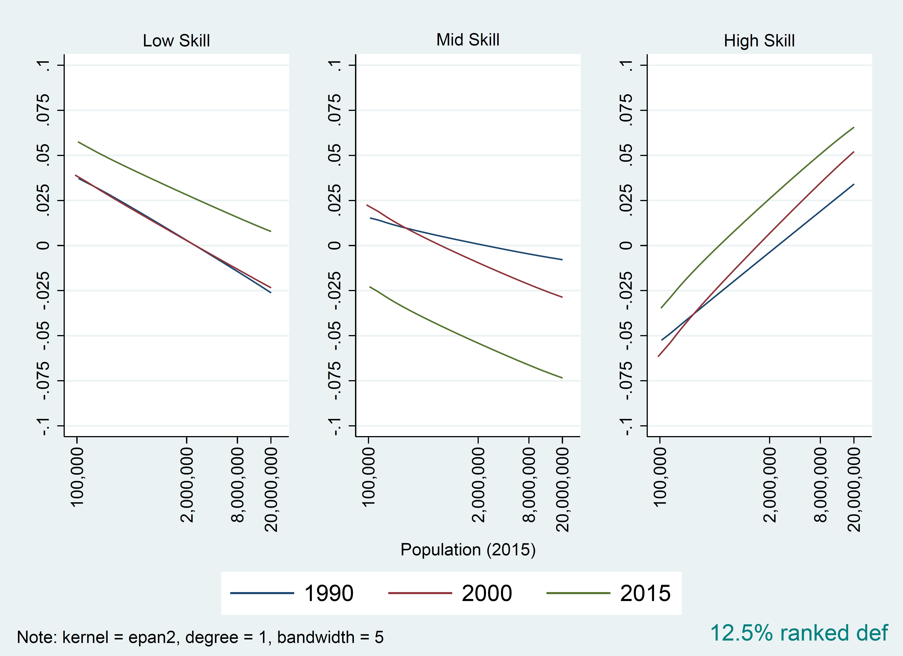
III. Occupational Employment Shares among US-Born Workers by MSA population, 1990-2015
Notes:
- Then lets only consider us-born workers,
with 1990 mean wage definition, we can observe a similar pattern; while, the difference between large and small cities are more significant for all three job categories.

Slide 9
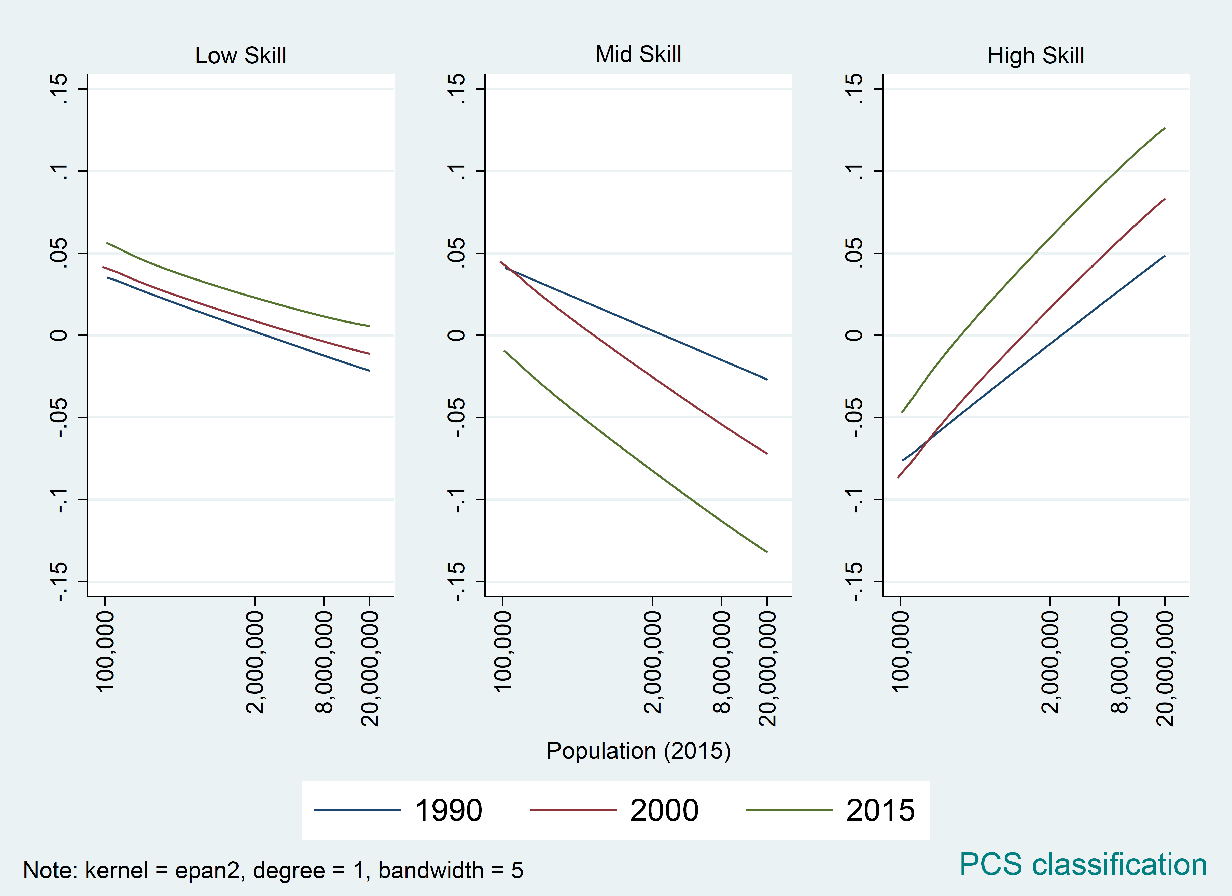
III. Occupational Employment Shares among US-Born Workers by MSA population, 1990-2015
Notes:
Using our French PCS classification, patterns are generally alike. But the changes for mid- and high- skill jobs are more significant than our previous definition. While low-skill line is flatter.

Slide 10
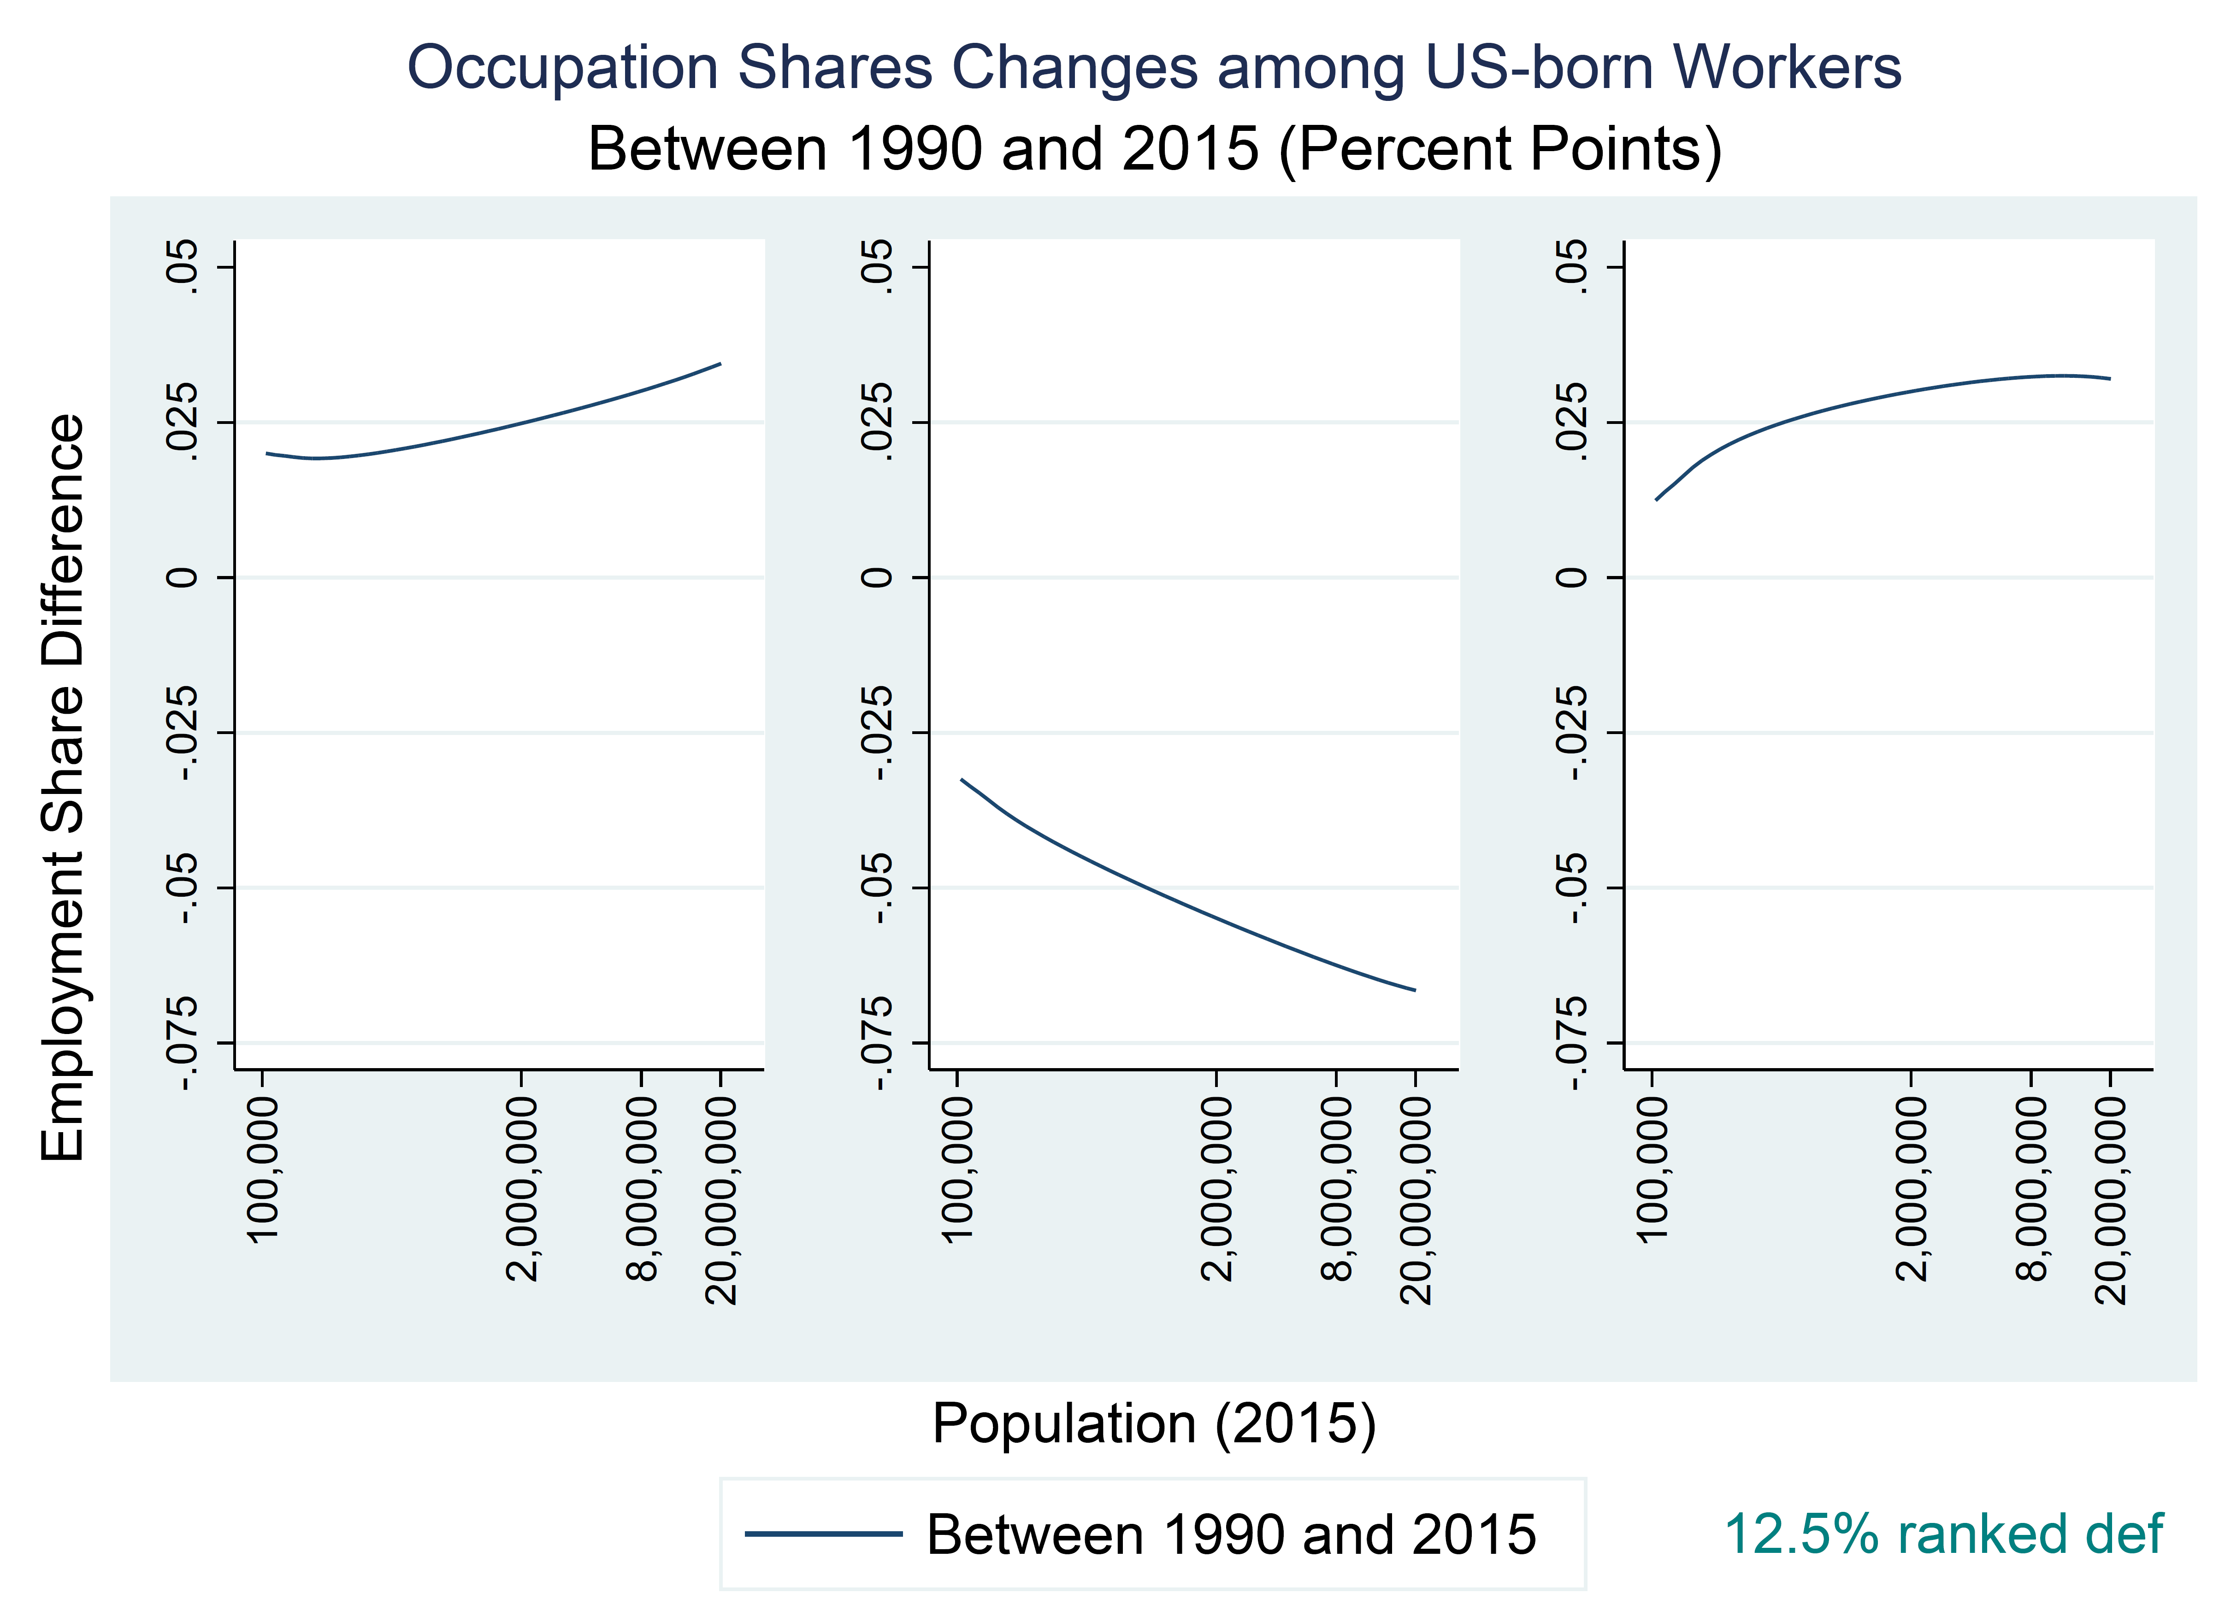
III. Occupational Employment Shares among US-Born Workers by MSA population, 1990-2015
Notes:
The discrepancy of changes between cities now are more clear for all LMH jobs

Slide 11
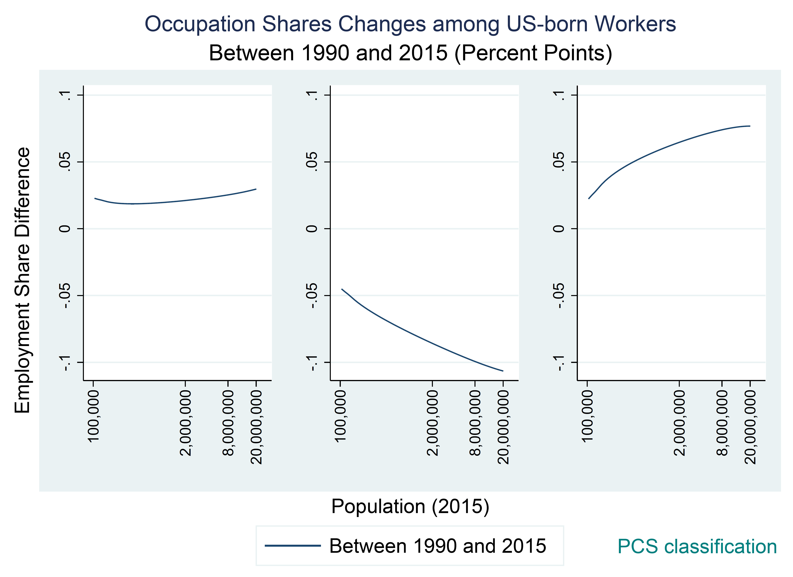
III. Occupational Employment Shares among US-Born Workers by MSA population, 1990-2015
Notes:
PCS definitions same, bigger degree for mid- & high-
But for low-skill jobs there's no big difference between cities.

Slide 12
IV. Reproduce Figure 7 with U.S. data

Slide 13
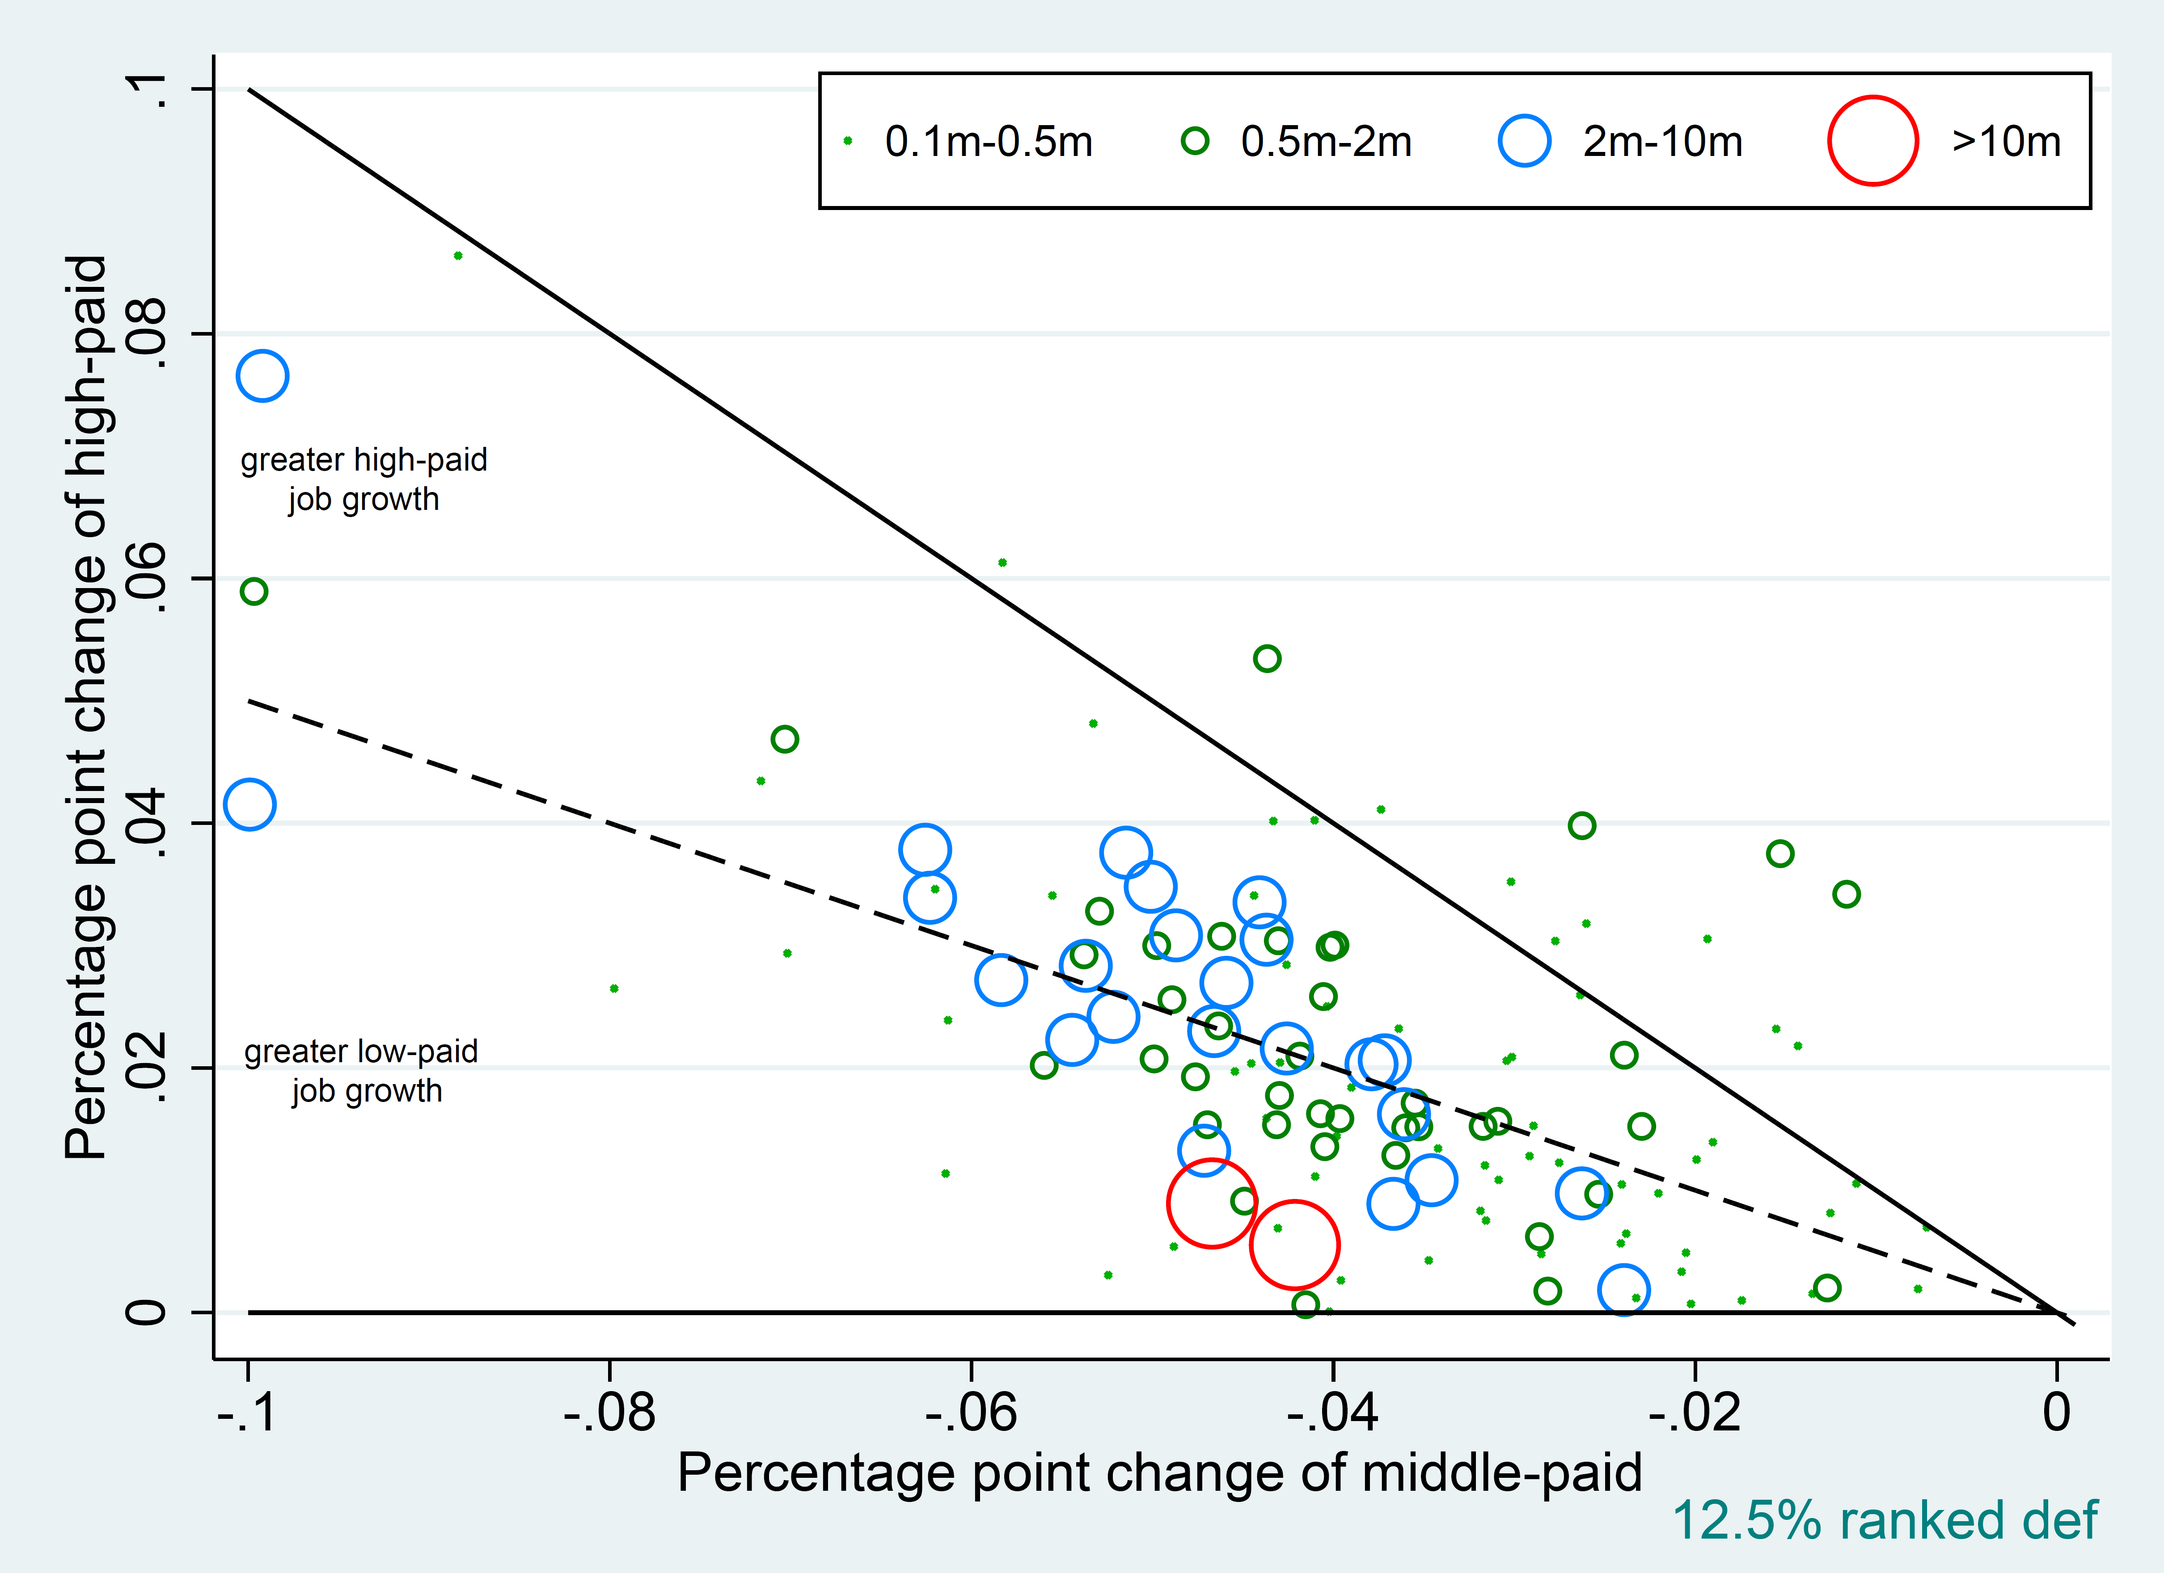
IV. Reproduce Figure 7 with U.S. data

Slide 14
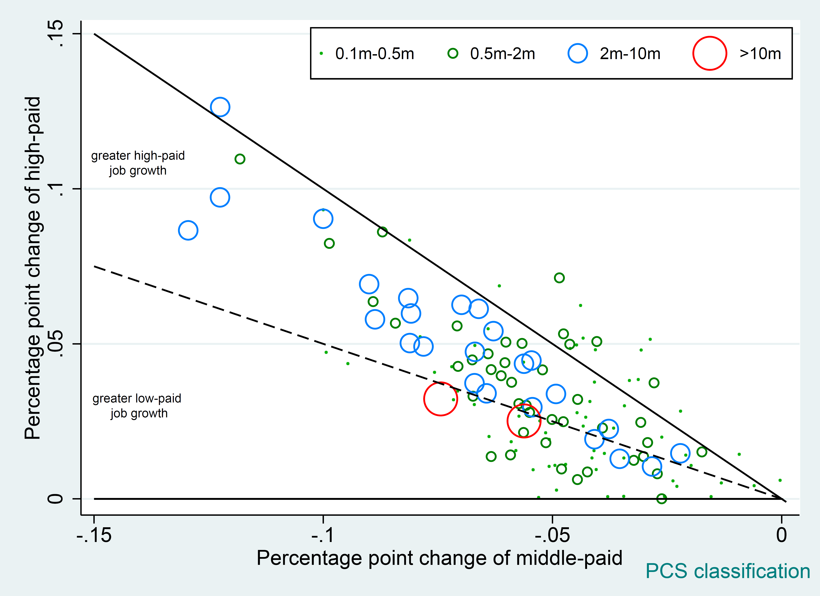
IV. Reproduce Figure 7 with U.S. data

Slide 15
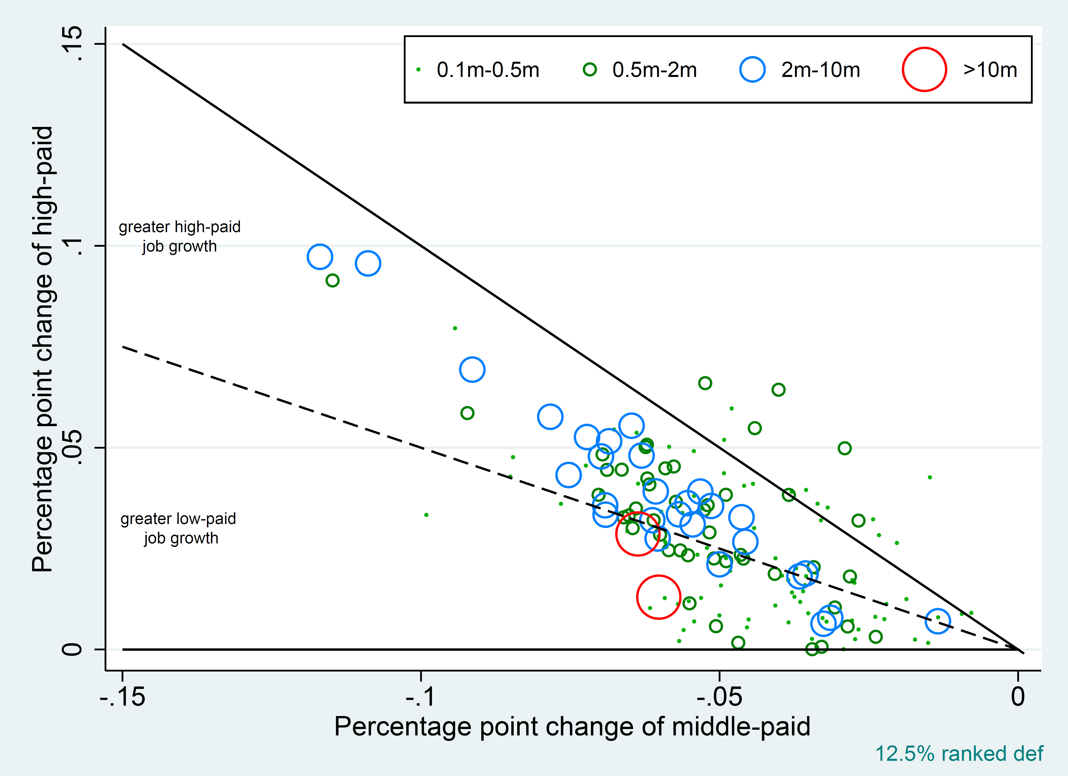
IV. Reproduce Figure 7 among only US-born workers

Slide 16
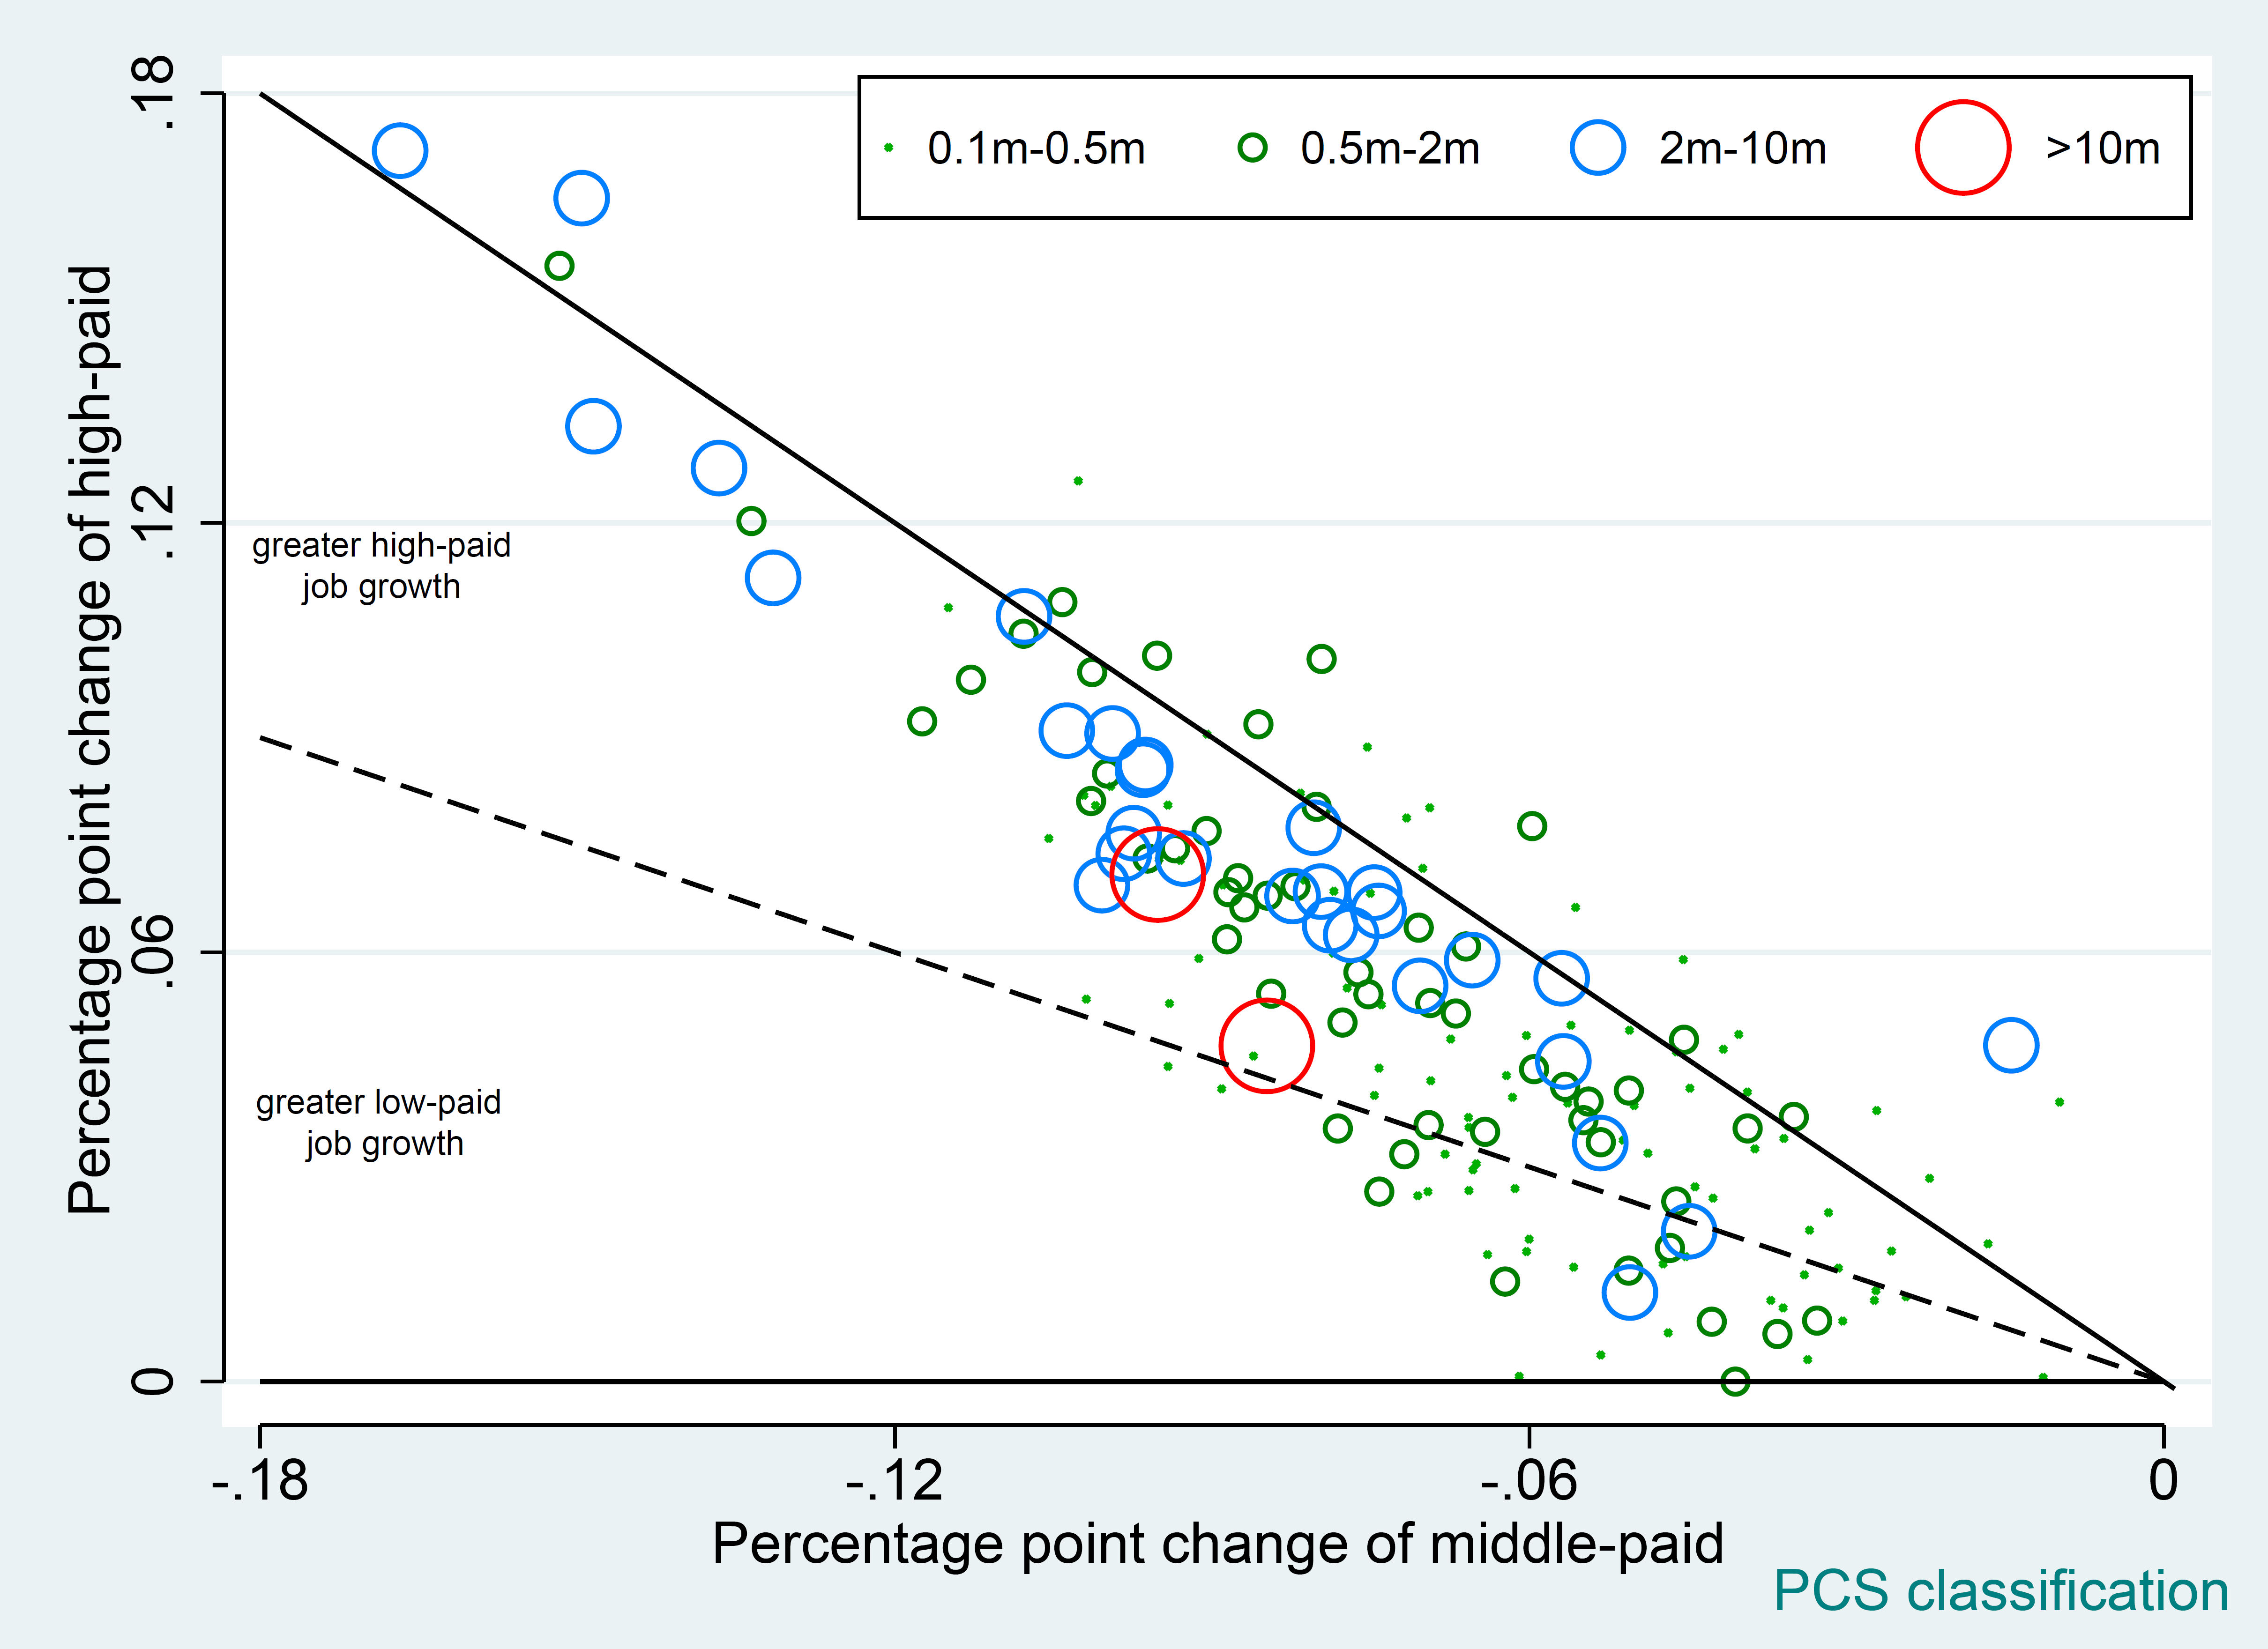
IV. Reproduce Figure 7 with U.S. data

Slide 17
Thank You!

